Slide 1
1:12-2:7

Slide 2
1:12-2:7
Helpful hom hints for accurit wether fourcasting forkasting
To tell the wether, go to yur bak dor and look for the dog.
If the dog is at the dor and he is wet, it is probubly raning.
But if the dog is standing ther rilly soking wet, it is probubly raning rilly hard.
If the dogz fur looks lik it has been rubed the rong way, it is probubly windy wendy.

Slide 3
1:12-2:7
Helpful hom hints for accurit wether fourcasting forkasting
If the dog has sno on his bak, it is probubly snoing.
Of cours, to be abul to tell the wether lik this, u haf to leef leev the dog outsid all the tim, espeshully if u expect bad wether.
– Sincerely, the Kat

Slide 4
1:12-2:7

Slide 5
1:12-2:7
1 Timothy 1:12–2:7 ~ ¹² And I thank Christ Jesus our Lord who has enabled me, because He counted me faithful, putting me into the ministry, ¹³ although I was formerly a blasphemer, a persecutor, and an insolent man; but I obtained mercy because I did it ignorantly in unbelief. ¹⁴ And the grace of our Lord was exceedingly abundant, with faith and love which are in Christ Jesus. ¹⁵ This is a faithful saying and worthy of all acceptance, that Christ Jesus came into the world to save sinners, of whom I am chief. ¹⁶ However, for this reason I obtained mercy, that in me first Jesus Christ might show all longsuffering, as a pattern to those who are going to believe on

Slide 6
1:12-2:7
1 Timothy 1:12–2:7 ~ Him for everlasting life. ¹⁷ Now to the King eternal, immortal, invisible, to God who alone is wise, be honor and glory forever and ever. Amen.
¹⁸ This charge I commit to you, son Timothy, according to the prophecies previously made concerning you, that by them you may wage the good warfare, ¹⁹ having faith and a good conscience, which some having rejected, concerning the faith have suffered shipwreck, ²⁰ of whom are Hymenaeus and Alexander, whom I delivered to Satan that they may learn not to blaspheme.
^{2:1} Therefore I exhort first of all that supplications, prayers, intercessions,

Slide 7
1:12-2:7
1 Timothy 1:12–2:7 ~ and giving of thanks be made for all men, ² for kings and all who are in authority, that we may lead a quiet and peaceable life in all godliness and reverence. ³ For this is good and acceptable in the sight of God our Savior, ⁴ who desires all men to be saved and to come to the knowledge of the truth. ⁵ For there is one God and one Mediator between God and men, the Man Christ Jesus, ⁶ who gave Himself a ransom for all, to be testified in due time, ⁷ for which I was appointed a preacher and an apostle—I am speaking the truth in Christ and not lying—a teacher of the Gentiles in faith and truth.

Slide 8
1:12-2:7

Slide 9
1:12-2:7
insolent (KJV, injurious) ~ hubristēs – hubris

Slide 10
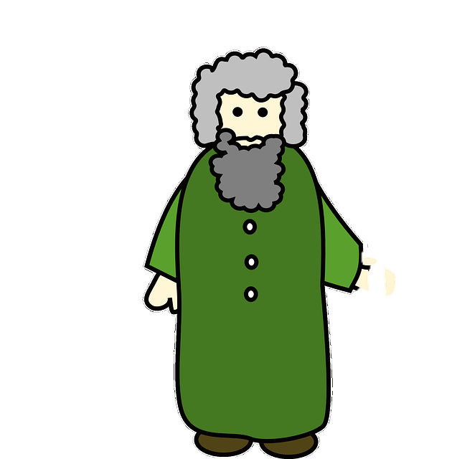
1:12-2:7
Paul T. Apostle

Slide 11
1:12-2:7
Paul’s conversion in route to Damascus
“I’m a sinner”
“I’m the chief of sinners”
Paul writes
1 Timothy
AD 35
AD 40
AD 45
AD 50
AD 55
AD 60
AD 65
Almost 30 years

Slide 12
1:12-2:7

Slide 13
1:12-2:7
Tim Hawkins ~ “This guy’s testimony is awesome. I hate my testimony. I wish I was addicted
to heroin. But no. I had to grow
up in a somewhat functional family situation. It’s just not fair. Why can’t I be a crack addict who robbed Fort Knox using nothing but a can of hairspray and a plastic ice cream scoop? Thanks a lot, God.”

Slide 14
1:12-2:7

Slide 15
1:12-2:7
2 Cor. 10:3-5 ~ ³ For though we walk in the flesh, we do not war according to the flesh. ⁴ For the weapons of our warfare are not carnal but mighty in God for pulling down strongholds, ⁵ casting down arguments and every high thing that exalts itself against the knowledge of God, bringing every thought into captivity to the obedience of Christ,

Slide 16
1:12-2:7

Slide 17
1:12-2:7
1 Tim. 1:5 ~ Now the purpose of the commandment is love from a pure heart, from a good conscience, and from sincere faith,

Slide 18
1:12-2:7

Slide 19
1:12-2:7
2 Tim. 2:17-18 ~ ¹⁷ And their message will spread like cancer. Hymenaeus and Philetus are of this sort, ¹⁸ who have strayed concerning the truth, saying that the resurrection is already past; and they overthrow the faith of some.
2 Tim. 4:14 ~ Alexander the coppersmith did me much harm. May the Lord repay him according to his works.

Slide 20
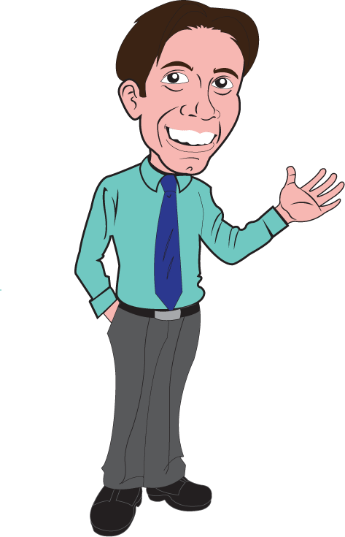
1:12-2:7
god of this world
Hedge of Protection
Joe Christian

Slide 21
1:12-2:7

Slide 22
1:12-2:7
Phil. 1:9 ~ And this I pray, that your love may abound still more and more in knowledge and all discernment,

Slide 23
1:12-2:7
Joe Focht ~ “There is no more confused message that you and I could give to a lost and dying world than to live in sin and at the same time to tell people about the transforming power of Jesus Christ. There isn’t a more confusing thing we can do to our kids and the generation behind us, to this world.
“God will not use a compromised life to reach a compromised world. God will use a life that is given over to Him, that is a demonstration of the message that through the power of Jesus Christ and His love He can transform our lives and set us free.”

Slide 24
1:12-2:7

Slide 25
1:12-2:7
NLT ~ I urge you, first of all, to pray for all people. Ask God to help them; intercede on their behalf, and give thanks for them.

Slide 26
1:12-2:7

Slide 27
1:12-2:7
Ezek. 33:11 ~ “Say to them: ‘As I live,’ says the Lord God, ‘I have no pleasure in the death of the wicked, but that the wicked turn from his way and live. Turn, turn from your evil ways! For why should you die, O house of Israel?’”
2 Pet. 3:9 ~ The Lord is not slack concerning His promise, as some count slackness, but is
longsuffering toward us, not willing that any should perish but that all should come to repentance.

Slide 28
1:12-2:7

